Slide 1
Introduction to Tableau
Part 7
Notes:
Welcome back to Data Society! We have a great class ahead of us today.

Slide 2
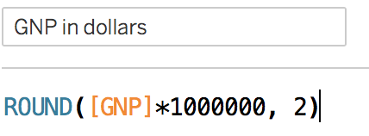
Recap: basic function syntax
Function parts:
Built in functions
control flow (black)
math operations (=,-,/,*...)
logical operators (<, >, =)
math functions (blue)
Fields from data pane (orange)
Strings (demarcated by “ ”)
Integers
Column name
Function arguments
Math operation
Data field
Math operator
Notes:
The purpose of this slide is to recap the basic elements of Tableau function syntax.

Slide 3
Recap: function types
Just like SQL functions, Tableau functions are classified into several types.
These include:
Number Functions
String Functions
Date Functions
Type Conversion
Logical Functions
Aggregate Functions
Pass-Through Functions (RAWSQL)
User Functions
Table Calculation Functions
Spatial Functions
Additional Functions
To see Tableau functions separated by type, visit this page [link].
Notes:
The purpose of this slide is to introduce the typology of functions native to Tableau. COMPARE these categories to the function types in SQL. EXPLAIN what some of these function types mean, especially Number Functions and Aggregate Functions (since they’re the next function types you’ll be exploring in detail on Day 4).

Slide 4
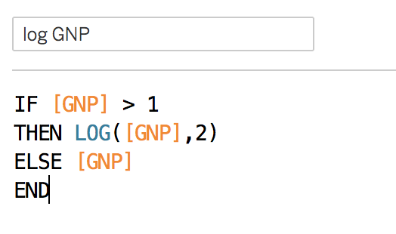
Recap: function control flow
This is a simple function that gets the log of the GNP data column.
Base 2 log for values > 1.
Otherwise it takes the value.
Column name
control flow elements (black)
data field
(orange)
Math operation (blue)
function END
Notes:
The purpose of this slide is to recap the basic elements of control flow using Tableau function syntax.

Slide 5
Reminder: save your work!
In the upcoming modules, we will be creating more elaborate visualizations.
We will see a lot of different insights from the data as we learn more in Tableau.
Make sure to save all your classwork (including Exercises), because we will be putting it all together at the end of the unit to create a story.
Notes:
The purpose of this slide is to remind students to save their work.

Slide 6

Video: table calculations
Table calculations are an extremely useful way to perform basic operations on your dataset within Tableau.
Before we practice using them together, click the link below and watch a short video from Tableau walking through using both pre-built (Quick) and custom table calculations.
Transform Values with Table Calculations - Tableau (link)
Notes:
The purpose of this slide is to allow students some time to watch a quick introductory video about table calculations before introducing the topic in the slides. Video length is approx. 4 minutes.

Slide 7
Module completion checklist
Objective | Complete
Implement table calculations with dataset
Understand addressing and partitioning fields
Explore level of detail (LOD) functions
Implement number calculations on given dataset
Implement aggregate calculations on given dataset

Slide 8
Table calculations
Table calculations give you calculations derived from the view, such as:
Rank
Percentile
Moving average
Difference
Running total
These calculations do not consider any measures or dimensions that are filtered out of the visualization.
Today, we’ll learn how to implement table calculations on our dataset.
Notes:
The purpose of this slide is to offer an overview of table calculations. DEFINE the term, and EXPLAIN how table calculations are based only on the visualization view.

Slide 9
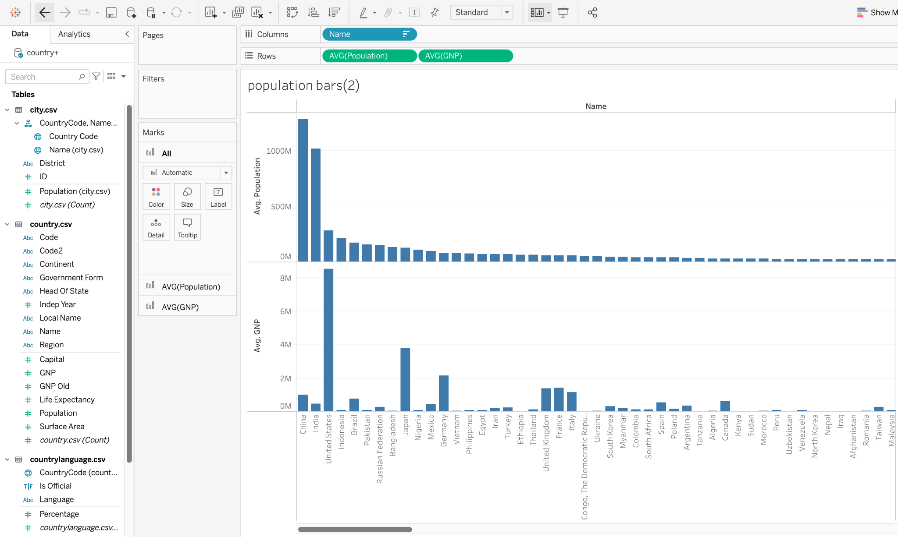
Create population chart by country
Drag the “Name” field from the country table and drop it in the “Columns” shelf.
Drag and drop the average population and average GNP fields into the “Rows” shelf.
Notes:
The purpose of this slide is to create the visualization that will serve as the basis for the table function built and applied over the rest of this section. WALK THROUGH how to produce this visualization as specified on the slide.

Slide 10
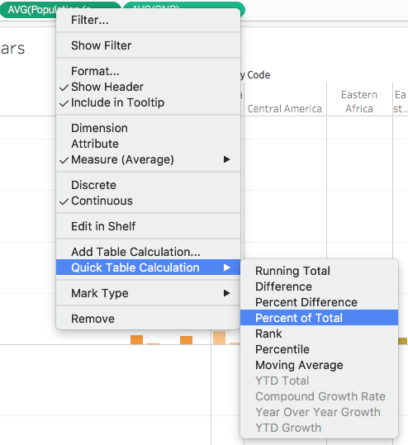
Create a table function (Option 1)
There are two ways to implement table calculations in Tableau.
Option 1: Quick table calculations
Right click on the appropriate pill and get a menu of quick calculations.
Note that the options change based on the selected element.
Notes:
The purpose of this slide is to introduce the first way to create a table function, using quick table calculations available in the right-click dropdown menu. WALK THROUGH how to locate this menu.

Slide 11
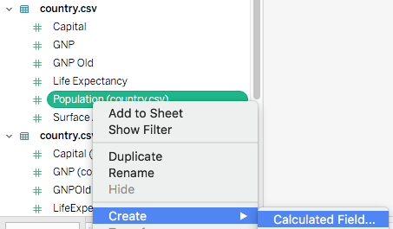
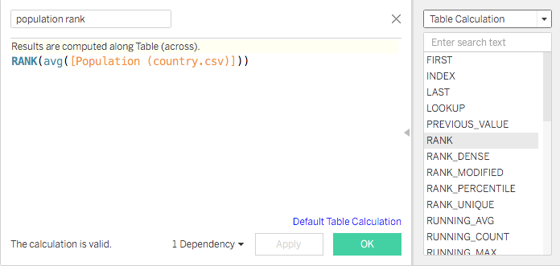
Create a table function (Option 2)
Option 2: Manual calculations
Right click a Measure > Create > Calculated Field.
From calculations dropdown menu at top right, select “Table Calculation.”
Write formula for required calculation.
Let’s calculate a ranked order list of average population by country.
Notes:
The purpose of this slide is to introduce the second way to create a table function, by selecting a measure and creating a calculated field. WALK THROUGH how to complete this process.

Slide 12

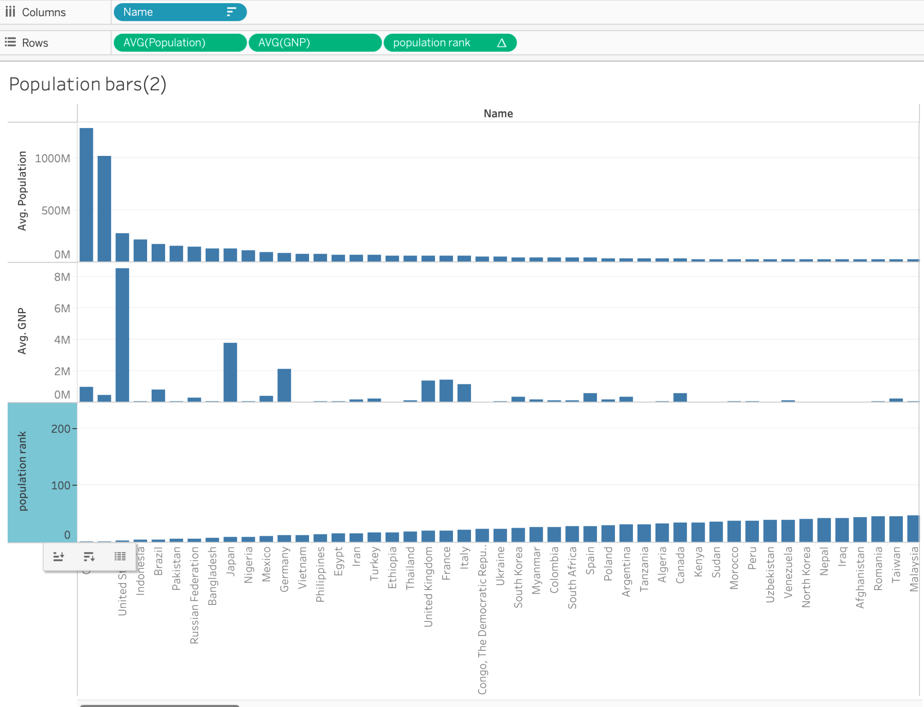
Add a table function to the plot
Let’s use the ranked population formula that we just made.
When we drag it to the data shelf, a triangle indicates that this is a calculated field derived from a table.
We can add population rank to our population visualization and sort it.
What can we infer from this visualization?
Notes:
The purpose of this slide is to demonstrate how to add a table function to the plot. WALK THROUGH how to add the ranked population formula to the data shelf. ASK students the question at the bottom of the slide and COMMENT on their responses.

Slide 13
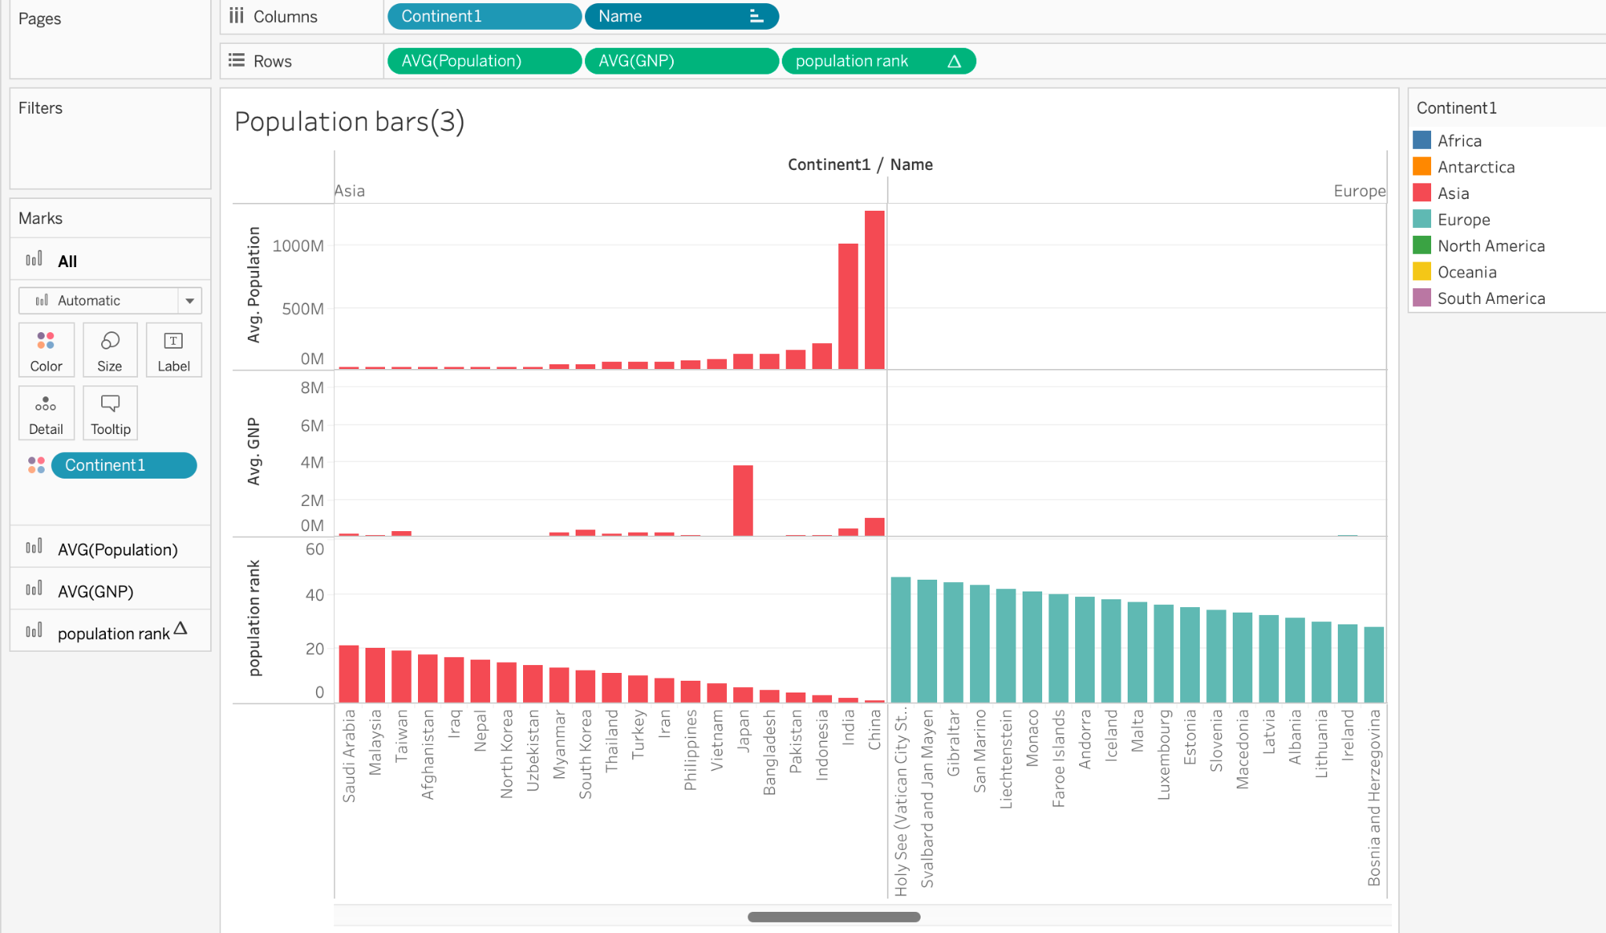
Split by continent
Drag the Continent dimension to the “Columns” shelf.
Add continent to the colors “Marks” table.
This will allow us to see how table calculations work.
Notes:
The purpose of this slide is to use the continent parameter to show how table calculations affect the structure of the data. WALK THROUGH how to complete these steps.

Slide 14
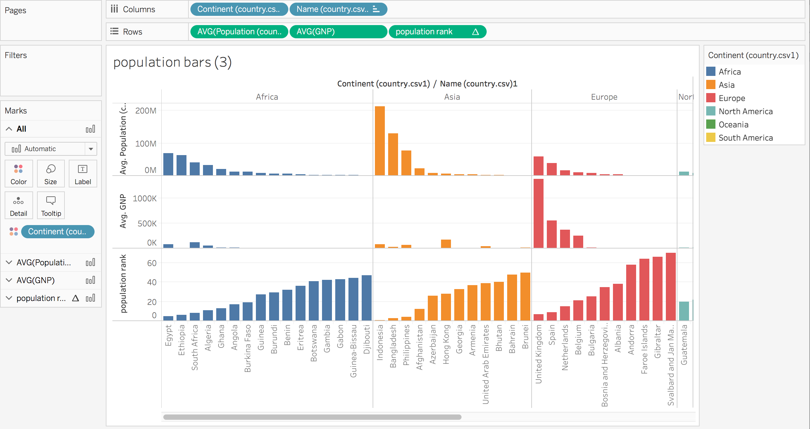
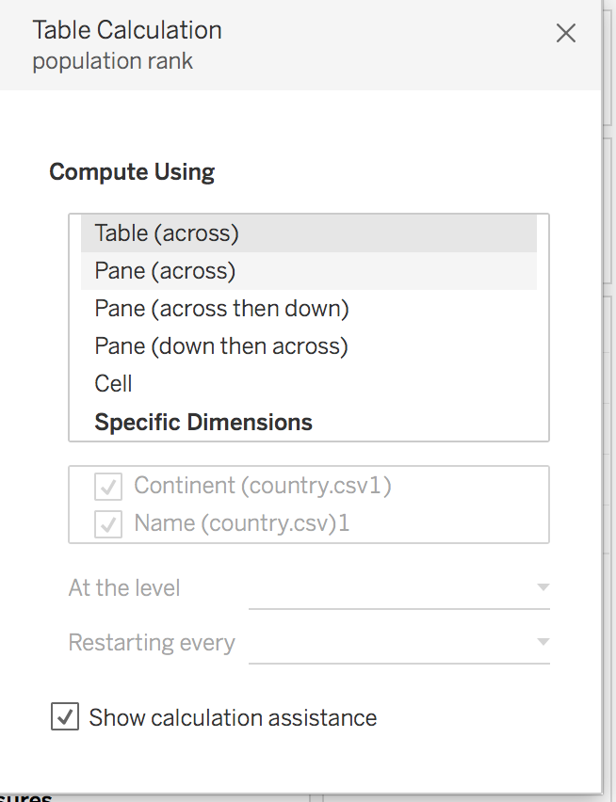
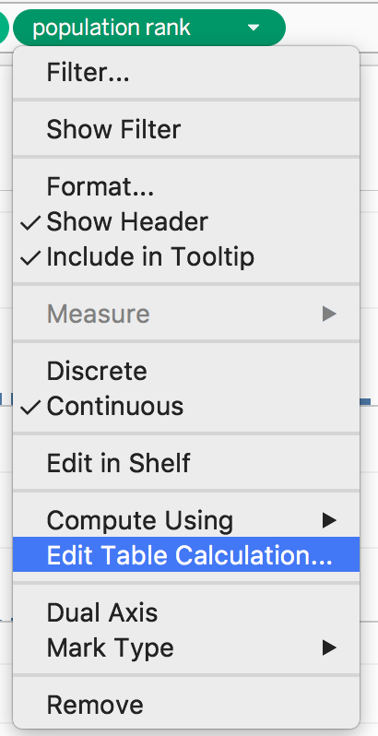
Modify the table calculation
Our view now uses color to separate the dataset by continent.
Click the “population rank pill” with the triangle.
Look at “Compute Using”, then go to “Edit Table Calculation” to see a live demo.
Toggle between two “Specific Dimensions” options: checking and unchecking “Continent.”
Notes:
The purpose of this slide is to encourage students to toggle between two different but related data visualizations, one that uses the Population Rank table function, and one that does not.

Slide 15
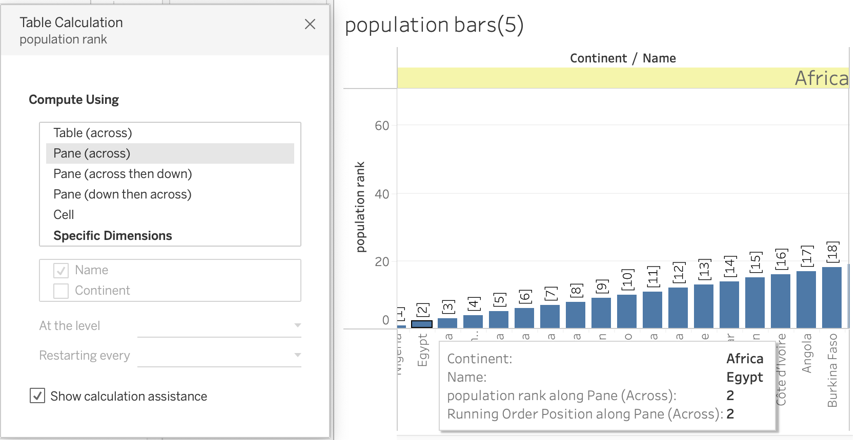
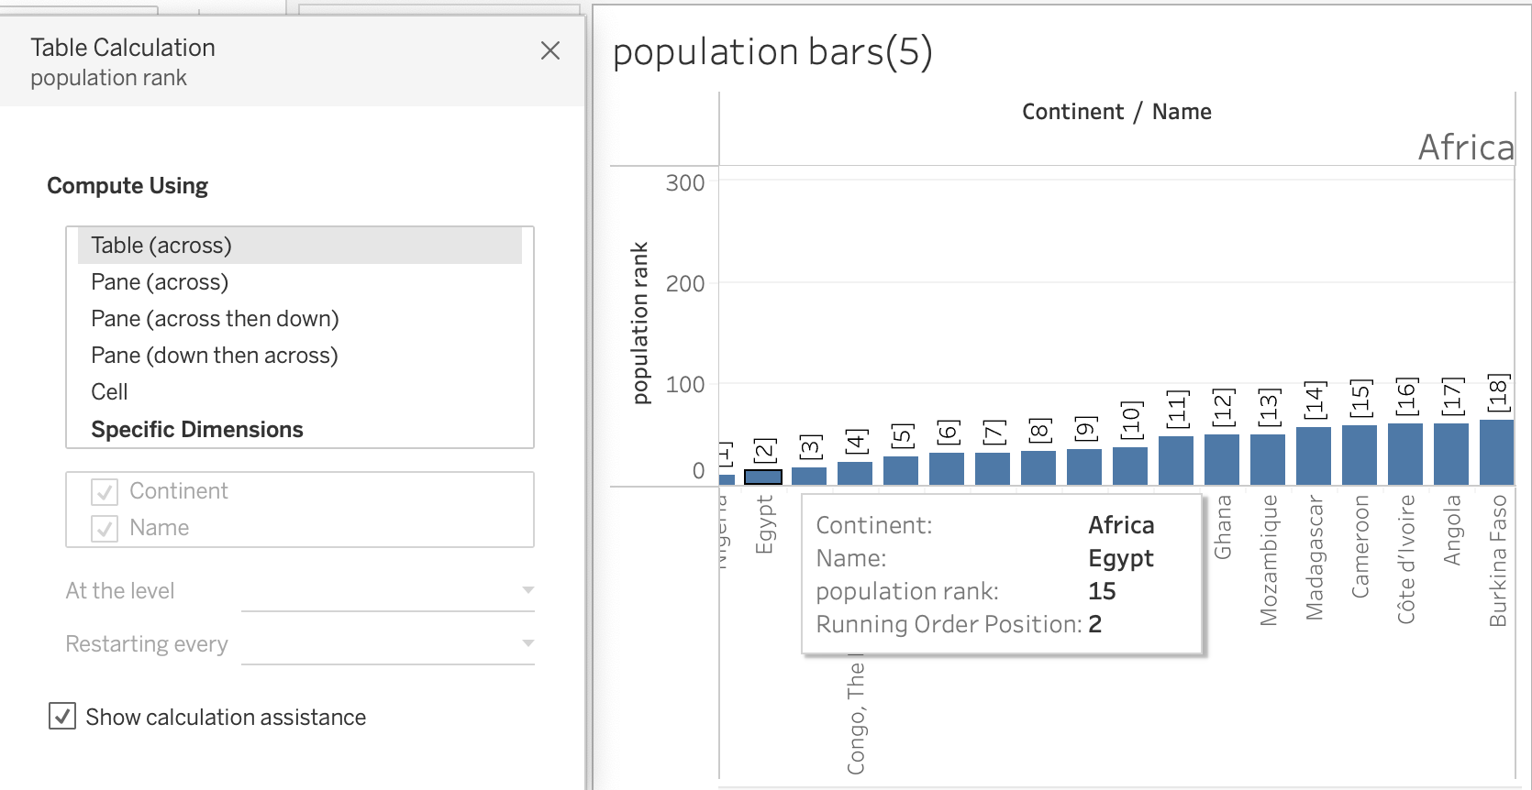
How table functions affect data
The difference in this case is subtle, but you can see it if you focus on Egypt.
Within Africa (pane), Egypt’s population is ranked #2.
Across the whole dataset (table), Egypt’s population is ranked #15.
The table function computes across the length of the entire table.
Notes:
The purpose of this slide is to simultaneously show two different but related data visualizations to represent how table functions affect data. EXPLAIN that in this case, the table function changes the rank order of various countries based on whether it is used (i.e. aggregating by continent) or not.

Slide 16

Module completion checklist
Objective | Complete
Implement table calculations with dataset
Understand addressing and partitioning fields
Explore level of detail (LOD) functions
Implement number calculations on given dataset
Implement aggregate calculations on given dataset

Slide 17
Addressing vs. partitioning fields
The Specific Dimension options that we just explored relate to the scope of the data on which the table function is performed and the direction in which the calculation moves through the table.
Addressing fields are those fields that define how you are computing through the table
in other words, the direction of the function.
Partitioning fields are how you are dividing the table up – in other words, the scope of the data the function will address.
Notes:
The purpose of this slide is to explain the two dimensions of a table function: its directionality, and its scope. EXPLAIN that addressing fields define the direction of the function, while partitioning fields divide the data, and thus change the function’s scope.

Slide 18
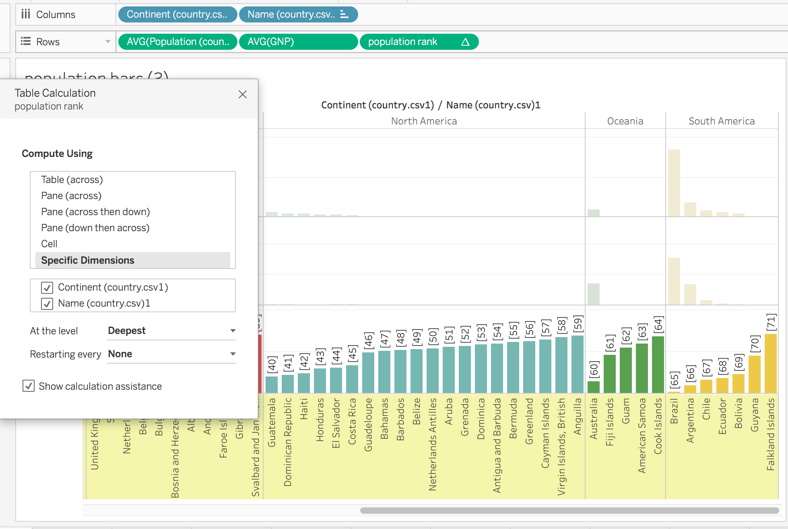
Addressing fields
We can change addressing and partitioning fields in the Edit Table Calculation menu, by selecting “Specific Dimensions.”
Continent is used for addressing.
We see that the rank calculation is table-wide, and that it runs the length of the entire table.
Notes:
The purpose of this slide is to show what happens when “Continent” is used as an addressing field in the table function.

Slide 19
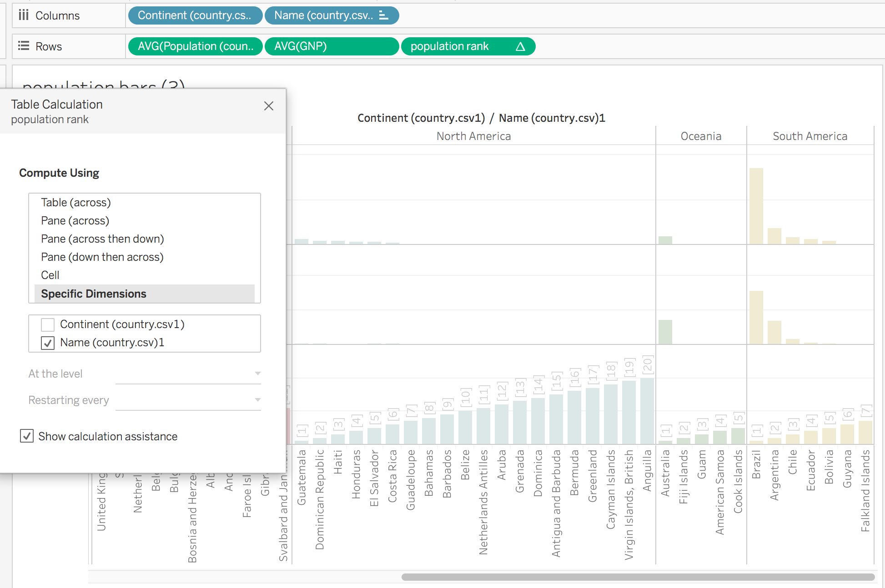
Partitioning fields
Continent is used for partitioning.
We also see that each continent ranks relative to itself, separating the data into subsets.
Notes:
The purpose of this slide is to show what happens when “Continent” is used as an partitioning field in the table function. EXPLAIN that the same Measurement can be used for both!

Slide 20
Knowledge check 7

Slide 21
Exercise 7

Slide 22
Module completion checklist
Objective | Complete
Implement table calculations with dataset
Understand addressing and partitioning fields
Explore level of detail (LOD) functions
Implement number calculations on given dataset
Implement aggregate calculations on given dataset

Slide 23
End of Part 7

